Slide 1
Prodigy Infotech
Hrushikesh Wagh
Notes:
ID=d924773e-9a16-4d6d-9803-8cb819e99682 Recipe=text_billboard Type=TextOnly Variant=0 FamilyID=AccentBoxWalbaum_Zero

Slide 2
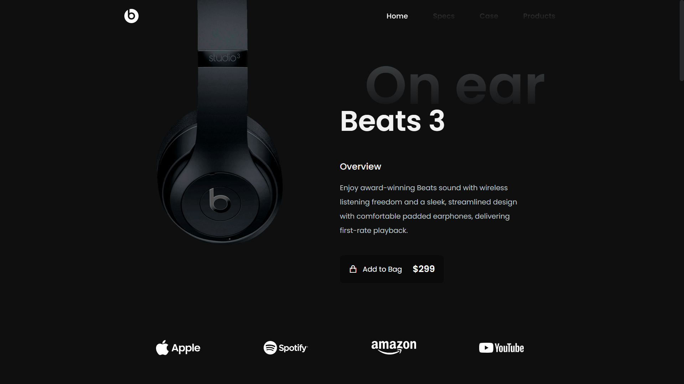
TASK 1
Create Responsive Landing Page

Slide 3
Requirements
Technologies: HTML, CSS, JavaScript
Code Editor: Visual Studio code
Web browser: Google Chrome, Edge, Brave

Slide 4
Let’s see the code

Slide 5
Let’s see the output

Slide 6
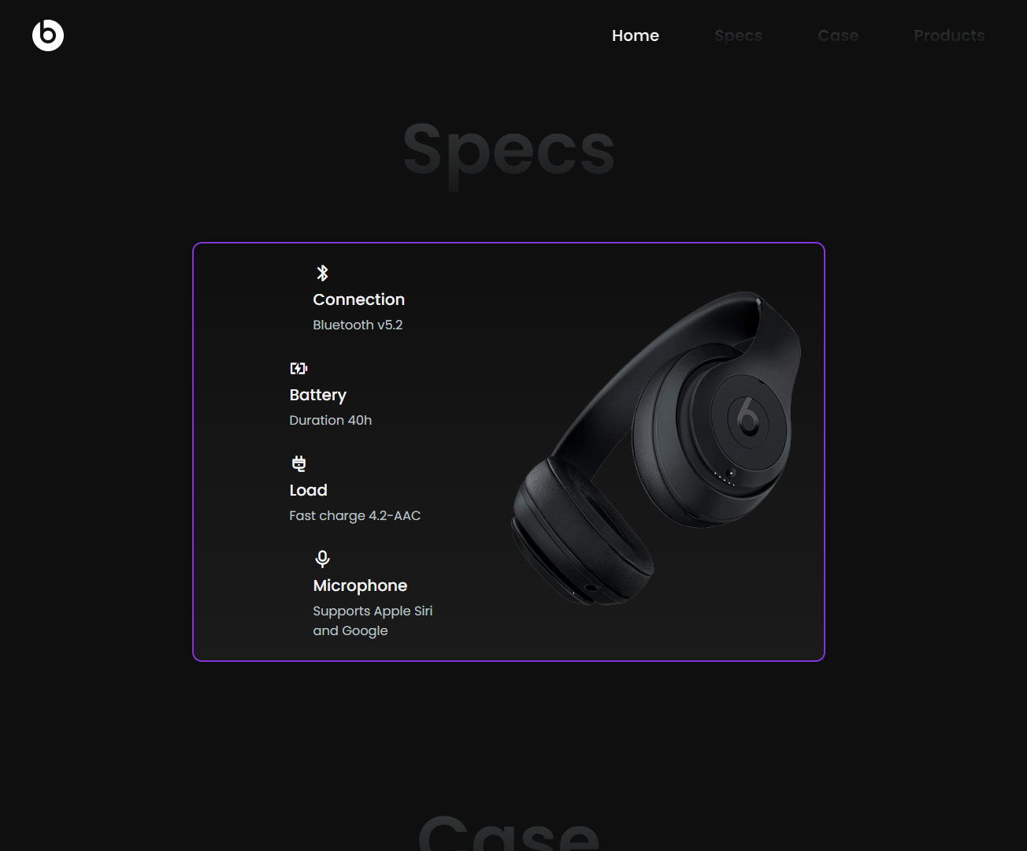

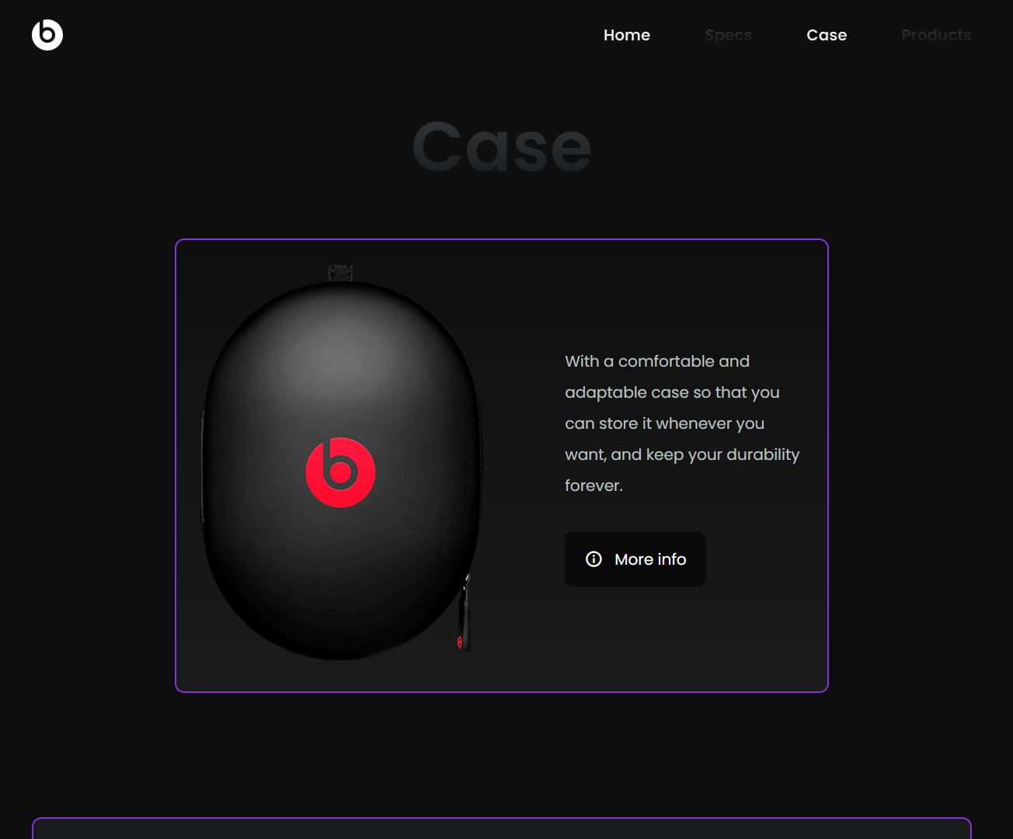
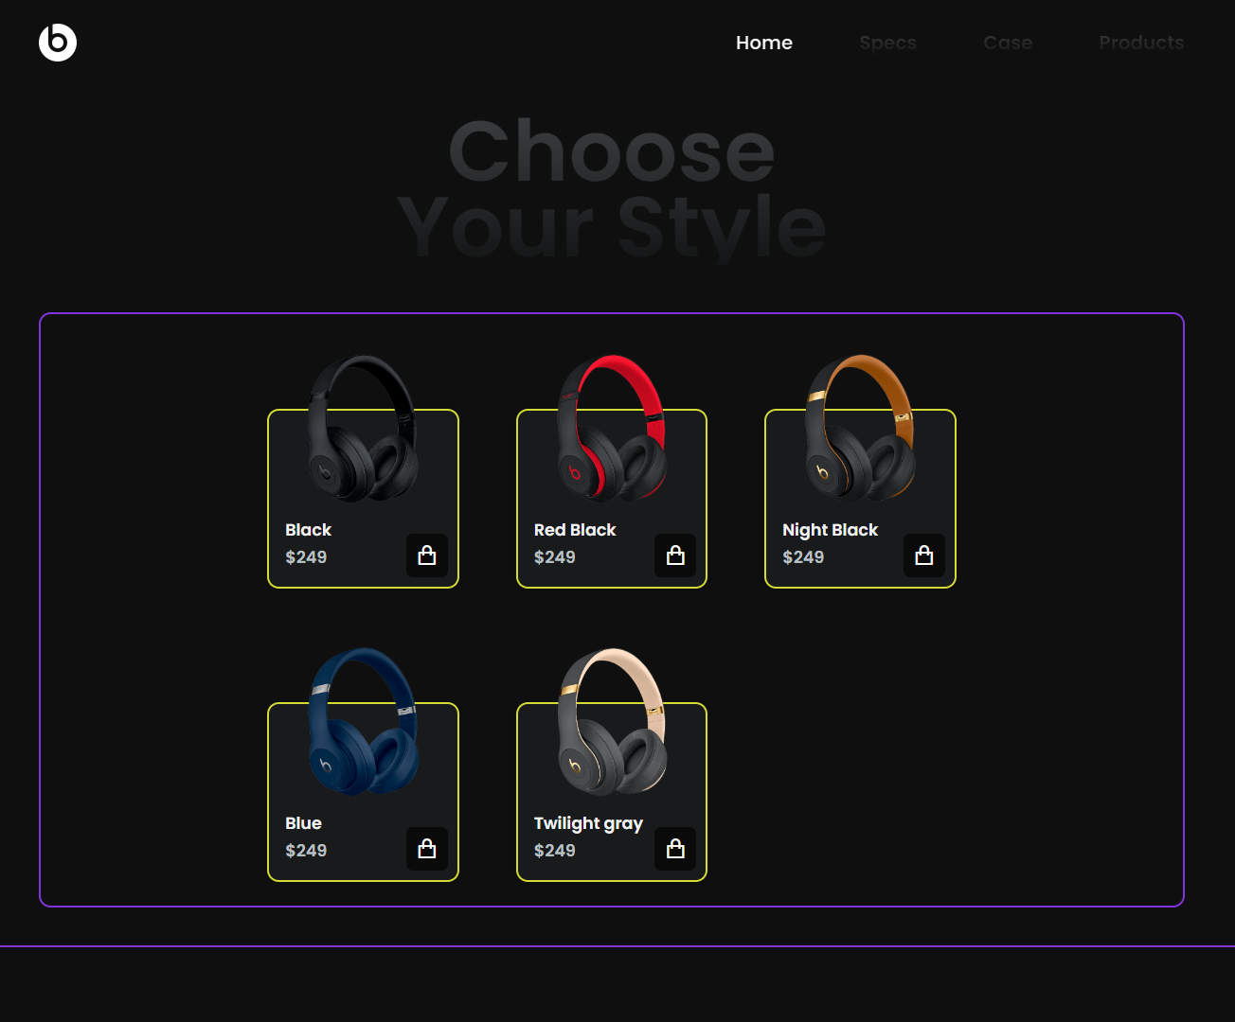


Thank you
Hrushikesh Wagh
hwagh864@gmail.com
https://sites.google.com/view/hrushikesh-wagh/home

